Slide 1
Hypothesis Testing, Regression, and Predictive Analytics
COMM 5559

Slide 2
Agenda
Hypothesis testing
Linear regressions
Logistic regressions
Neural networks
Model comparison
Prediction

Slide 3
Data and Goal
Two files
  Firm_data (Excel)
  New_firm_data (Excel)
Goal
  Examine the relation between various client firm characteristics and (1) audit fees and (2) the choice of a Big 4 auditor
  Compare the performance of regressions and neural networks
  Predict the audit fees and Big 4 choices for the new firms

Slide 4
Do Big 4 Audit Firms Charge More?
Let’s import the Firm_data and use a Summarize tool to compare the average log of audit fees for Big 4 vs. non-Big 4 audit firms
What do you find?

Slide 5
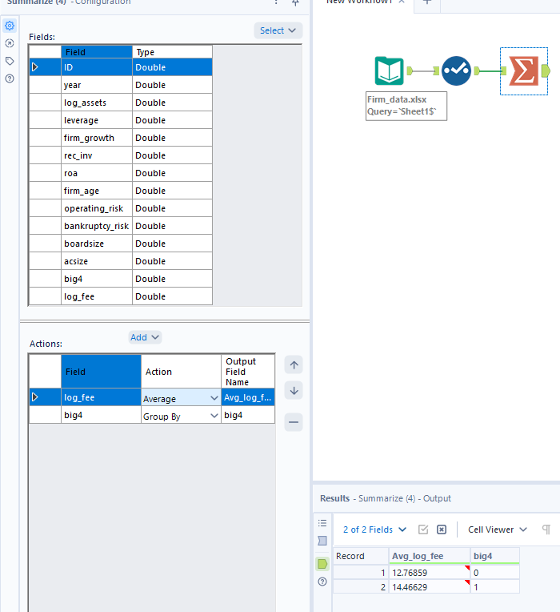
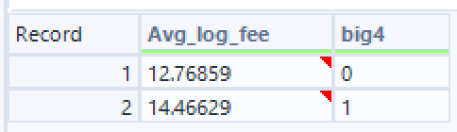
Comparison
Can we conclude that Big 4 audit firms charge more? Why?
Can’t, difference might be random / no testing done

Slide 6
The Determinants of Audit Fees
=
Firm Characteristics
Random Noise
Fee
“True” Big 4 effect
+
+
What we want to know
Size, profitability, accruals, etc.
Unobserved “noisy” factors

Slide 7
Sampling and Random Noise
Below are the audit fees of 6 randomly selected clients of each type of auditor. Do we see a difference in average audit fees?
What if we only sampled the first 5 clients?
Big 4 | 100 | 200 | 300 | 400 | 500 | 600
Non-Big 4 | 600 | 500 | 400 | 300 | 200 | 100
Non-big 4 would show higher

Slide 8
Hypothesis Testing in Plain English
H0
H1
Null hypothesis
Alternative hypothesis
There is no real difference in average audit fee between Big 4 clients and non-Big 4 clients.
The observed difference we see in the sample is just random variation.
There is a real difference in average audit fee between Big 4 clients and non-Big 4 clients.
The observed difference in the sample is too large to dismiss as random variation.

Slide 9



Test of Means
The Test of Means tool tests whether there is a difference between the means (i.e., averages) of two groups
  Using a t-test
The Test of Means tool has two outputs:
  D – the test results
  R – the test report; need to use the Browse Tool to view it

Slide 10
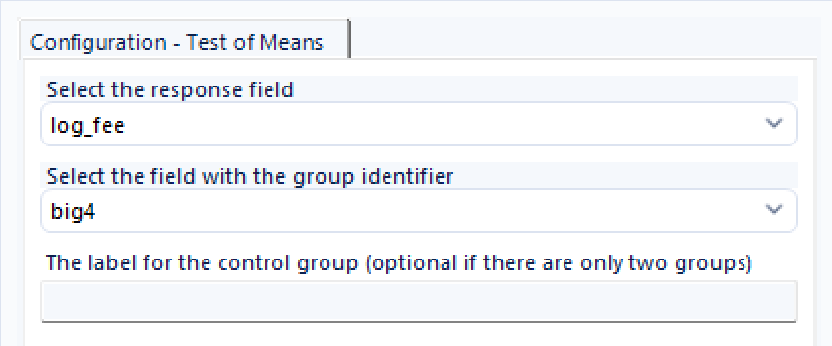
Configuration
v_string

Slide 11
Type I Error
The estimated sample difference is almost always different from the “true” difference
The Type I error is the mistake of estimating a non-zero difference when the true difference is zero
Mistake of claiming that there is a real difference, although the truth is that there is no difference (rejecting null when null is true)

Slide 12
P-Value and Statistical Significance
The p-value is the probability of making a Type I error
Small p-values indicate lower probabilities of making an error, i.e.,
  Higher confidence that the true difference is indeed non-zero
The difference is statistically significant if the p-value is small
  P-value < 0.01 => significant at the 1% level
  P-value < 0.05 => significant at the 5% level
  P-value < 0.10 => significant at the 10% level
Do this after doing summarize when investigating data to test that these means are significant

Slide 13
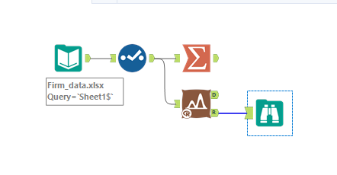
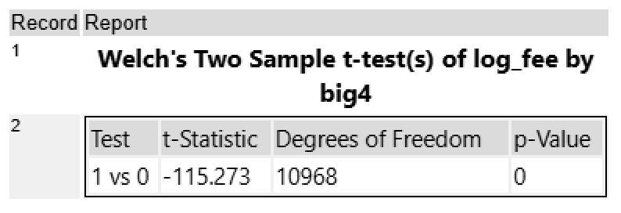
Comparison
Now, can we conclude that Big 4 audit firms charge more? Why?
T statistic tells direction (neg says second group has less mean)
In the equation from earlier, rly only accounting for randomness and big 4 effect – possible other variables contributing to this, so likely no

Slide 14
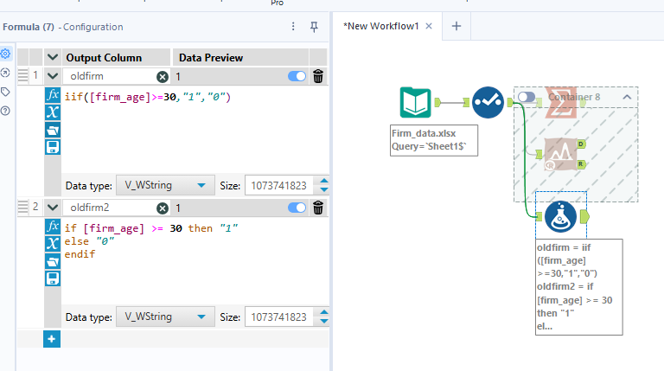
Indicator
Two types of creating indicators

Slide 15
Incorporating Firm Characteristics
Univariate Analysis
(t-test)
Multivariate Analysis
(regression)

Slide 16
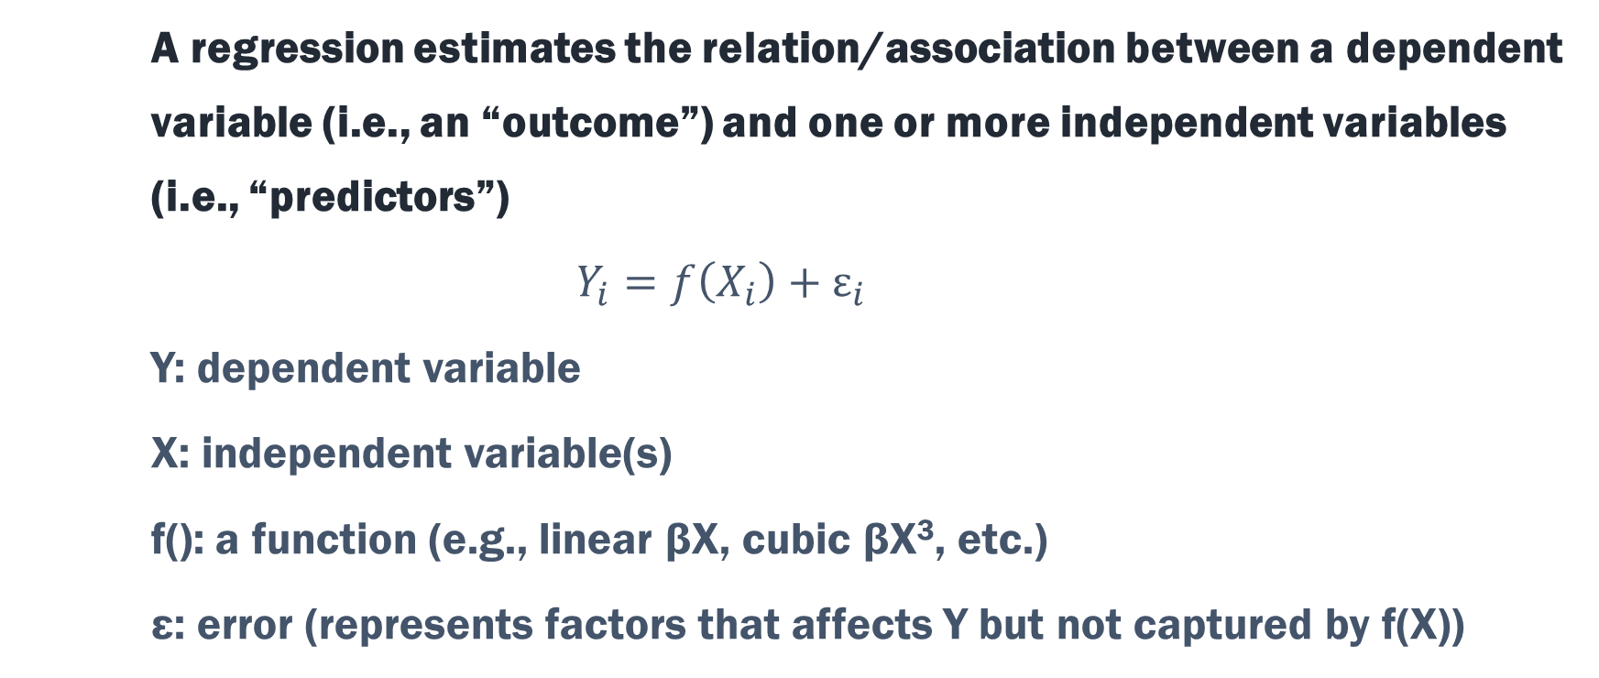
What is a Regression?
A regression estimates the relation/association between a dependent variable (i.e., an “outcome”) and one or more independent variables (i.e., “predictors”)
$$Y_{i}=f\left(X_{i}\right)+ε_{i}$$
Y: dependent variable
X: independent variable(s)
f(): a function (e.g., linear βX, cubic βX³, etc.)
ε: error (represents factors that affects Y but not captured by f(X))

Slide 17
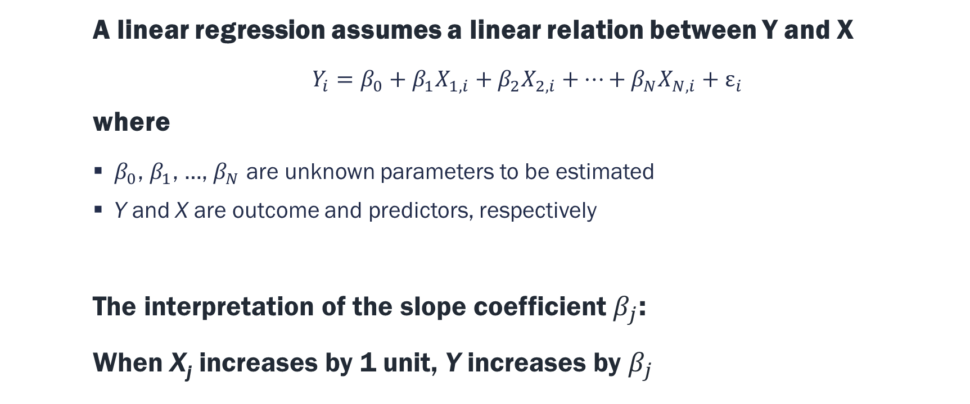
Linear Regressions
A linear regression assumes a linear relation between Y and X
  $Y_{i}=β_{0}+β_{1}X_{1,i}+β_{2}X_{2,i}+…+β_{N}X_{N,i}+ε_{i}$
where
  $β_{0}$, $β_{1}$, …, $β_{N}$ are unknown parameters to be estimated
  Y and X are outcome and predictors, respectively
The interpretation of the slope coefficient $β_{j}$:
When X_{j} increases by 1 unit, Y increases by $β_{j}$

Slide 18

Linear Regressions
The Linear Regression tool can be found under the Predictive Tools tab
  The predictive tools need to be installed separately
Set target variable (Y) and predictor variables (X)
The Linear Regression tool has 3 outputs:
  O – the estimated model (which is used for prediction and comparison)
  R – the estimation report; need to use the Browse Tool to view it
  I – the interactive report

Slide 19
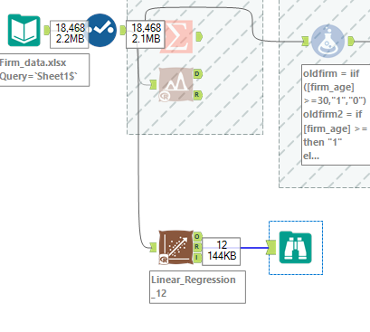
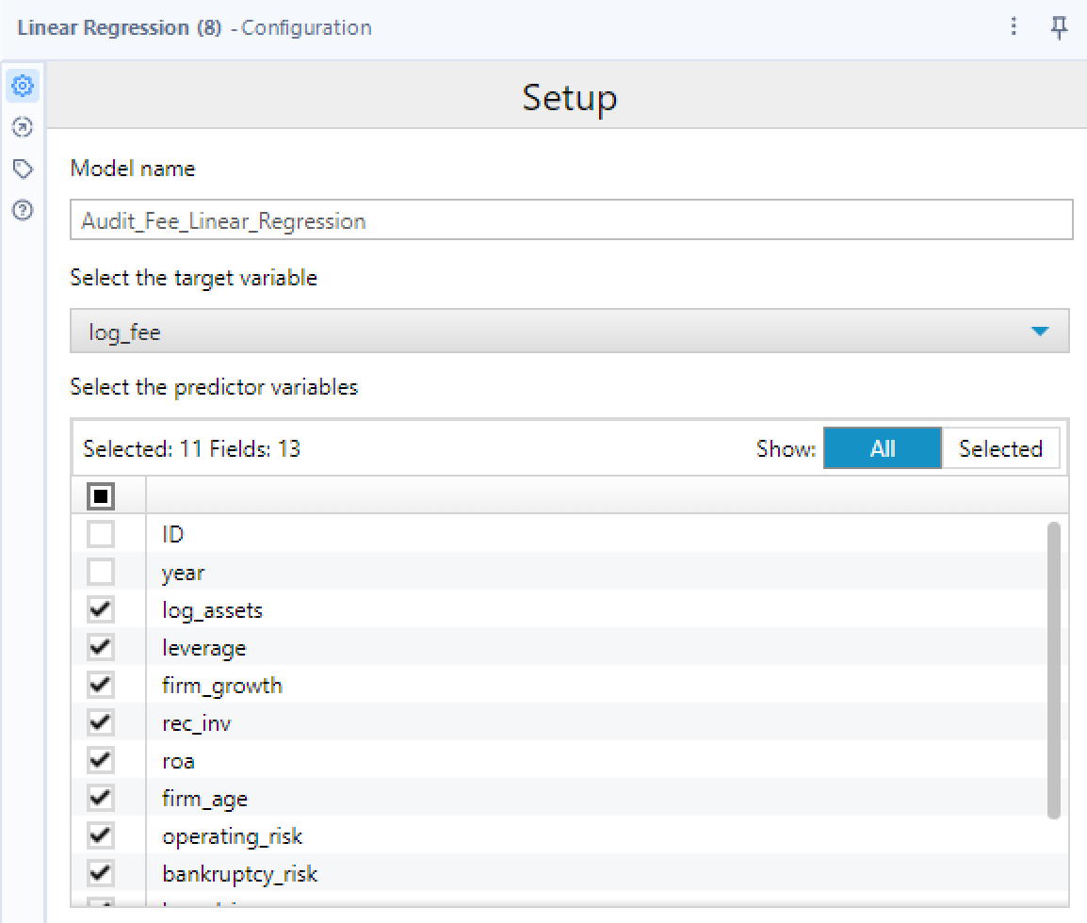
Configuration

Slide 20
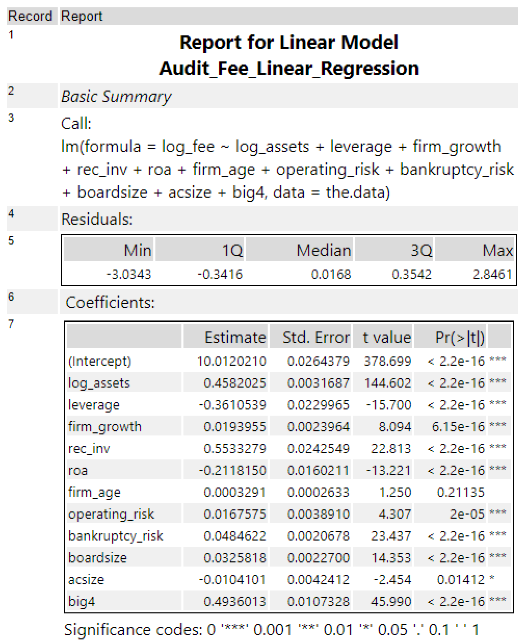
Report

Slide 21
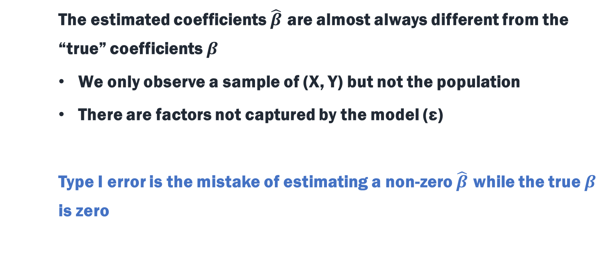
Again, Type I Error
The estimated coefficients $\hat{β}$ are almost always different from the “true” coefficients $β$
We only observe a sample of (X, Y) but not the population
There are factors not captured by the model (ε)
Type I error is the mistake of estimating a non-zero $\hat{β}$ while the true $β$ is zero

Slide 22
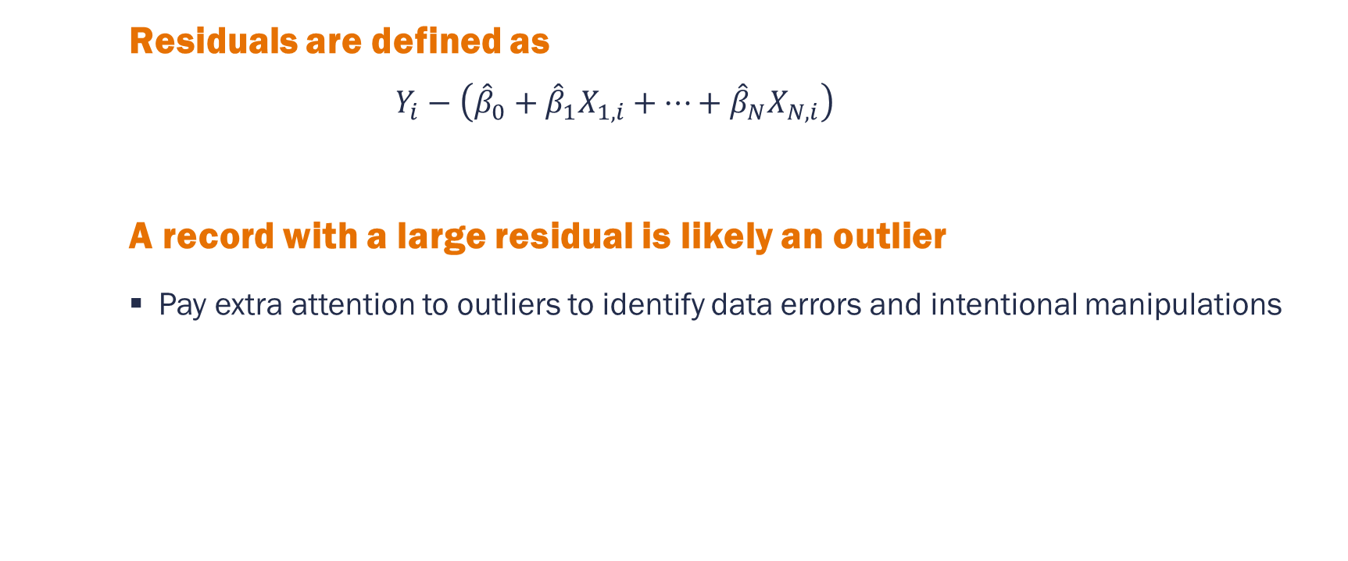
Residuals and Outliers
This is the predicted Y
Residuals are defined as
  $$Y_{i}−\left({\hat{β}}_{0}+{\hat{β}}_{1}X_{1,i}+…+{\hat{β}}_{N}X_{N,i}\right)$$
A record with a large residual is likely an outlier
  Pay extra attention to outliers to identify data errors and intentional manipulations

Slide 23
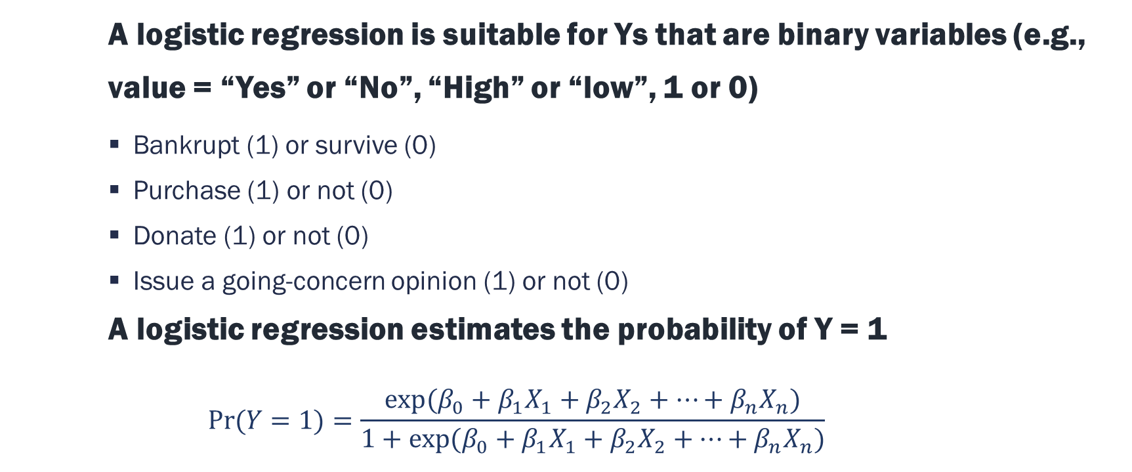
Logistic Regressions
A logistic regression is suitable for Ys that are binary variables (e.g., value = “Yes” or “No”, “High” or “low”, 1 or 0)
  Bankrupt (1) or survive (0)
  Purchase (1) or not (0)
  Donate (1) or not (0)
  Issue a going-concern opinion (1) or not (0)
A logistic regression estimates the probability of Y = 1
$$Pr⁡(Y=1)=\frac{exp⁡(β_{0}+β_{1}X_{1}+β_{2}X_{2}+…+β_{n}X_{n})}{1+exp⁡(β_{0}+β_{1}X_{1}+β_{2}X_{2}+…+β_{n}X_{n})}$$

Slide 24

Logistic Regressions
The target variable must be binary and text (e.g., V_String)
The 3 outputs of the Logistic Regression tool are:
  O – the estimated model (which is used for prediction)
  R – the estimation report, need to use the Browse Tool to view it
  I – the interactive report

Slide 25
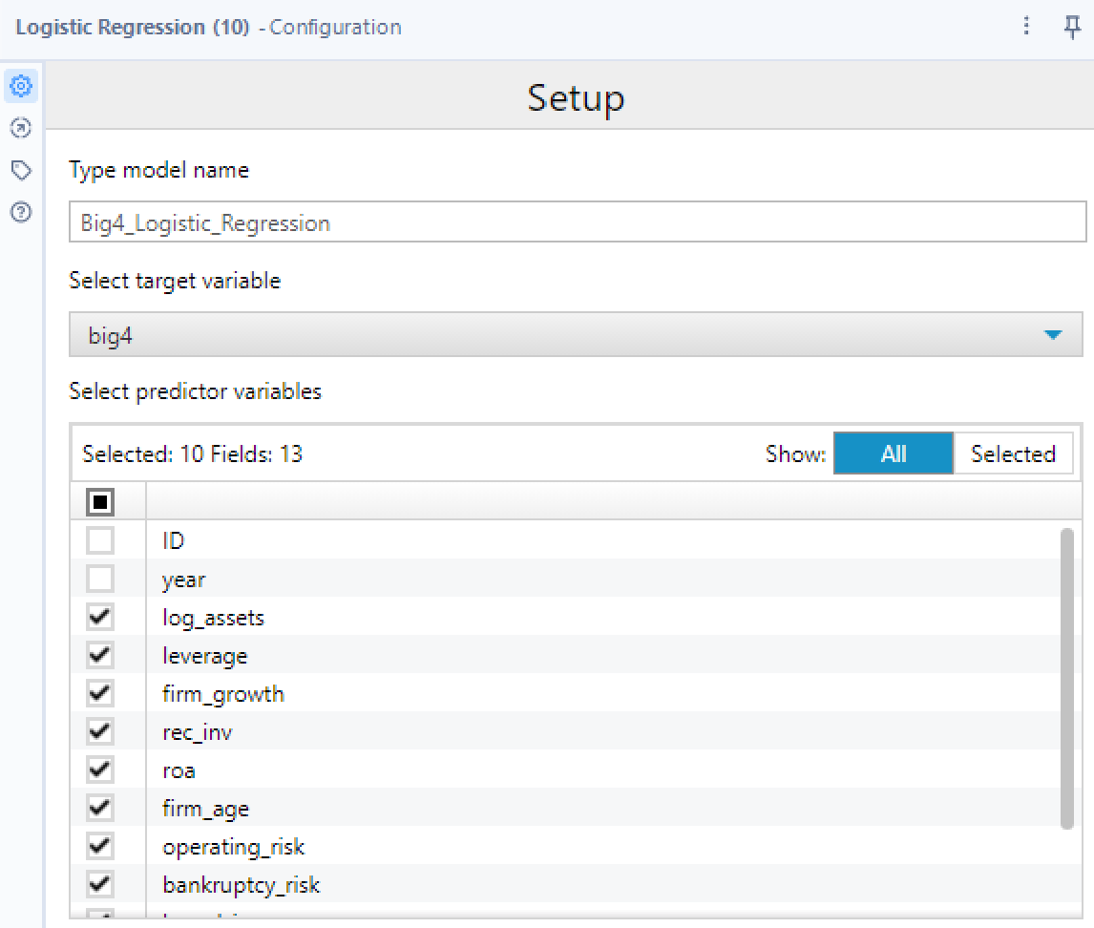
Configuration
Not including log_fee, bc we concluded it depends on big4

Slide 26
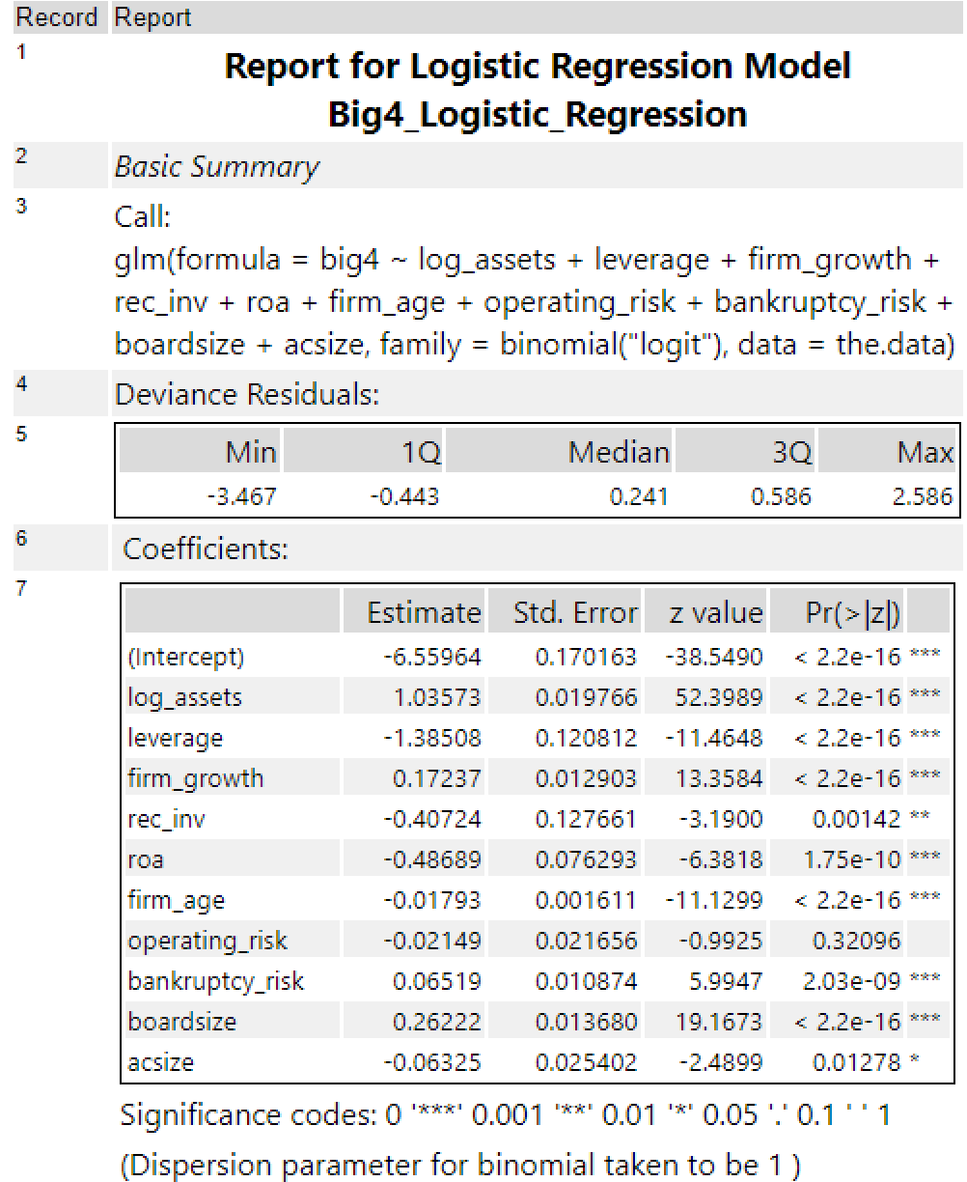
Report

Slide 27
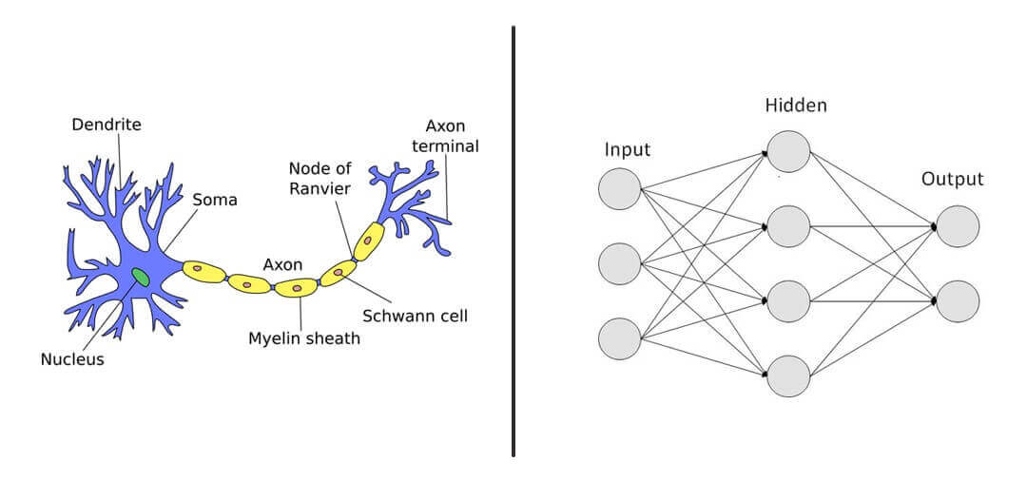
Neural Networks
A neural network is an algorithm that mimics the way the human brain operates
https://clevertap.com/blog/neural-networks/
Notes:
https://clevertap.com/blog/neural-networks/

Slide 28
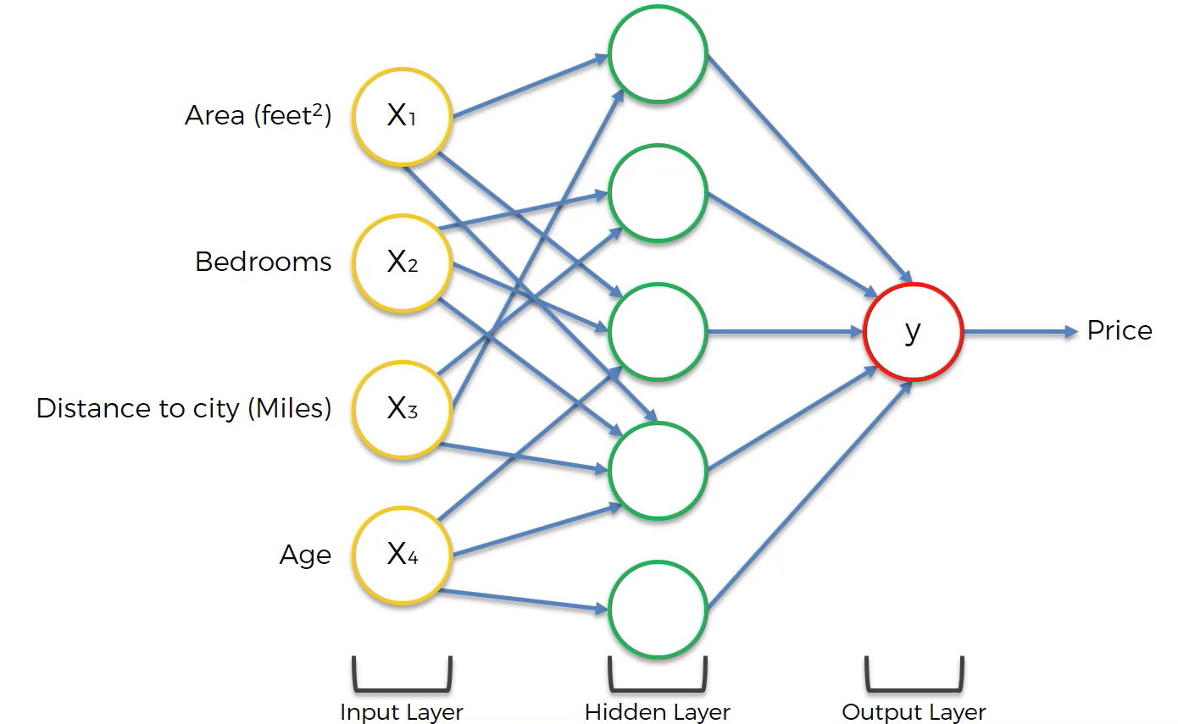
Neural Network Example
https://www.freecodecamp.org/news/deep-learning-neural-networks-explained-in-plain-english/
Neurons are activated by inputs
Notes:
https://www.freecodecamp.org/news/deep-learning-neural-networks-explained-in-plain-english/

Slide 29
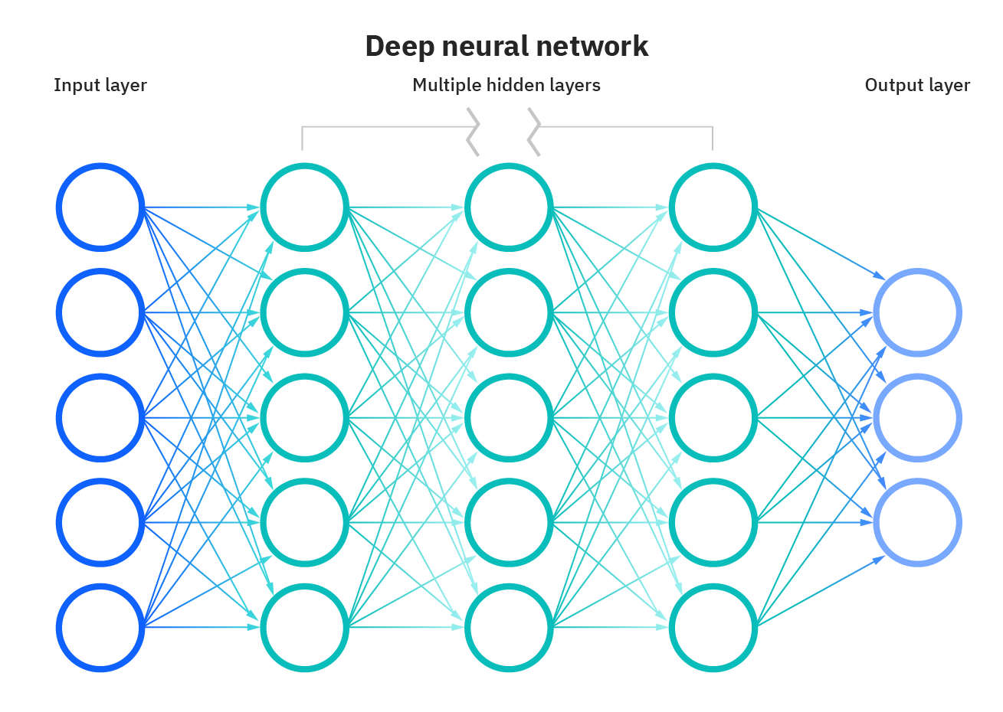
Deep Learning
https://www.pinecone.io/learn/transformers/
The “deep” refers to the depth of layers in a neural network that includes three or more layers, including the input and output layers
Notes:
https://www.pinecone.io/learn/transformers/

Slide 30

Neural Network
The Neural Network tool in Alteryx creates a single hidden layer
The neurons in the hidden layer use a logistic activation function
Can choose the number of neurons in the hidden layer (default is 10)

Slide 31
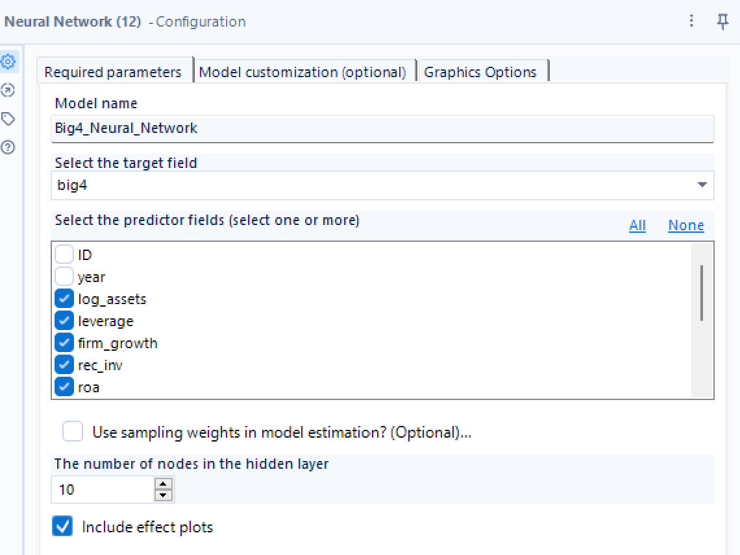
Configuration
Not including log_fee (and big4), bc we concluded it depends on big4

Slide 32


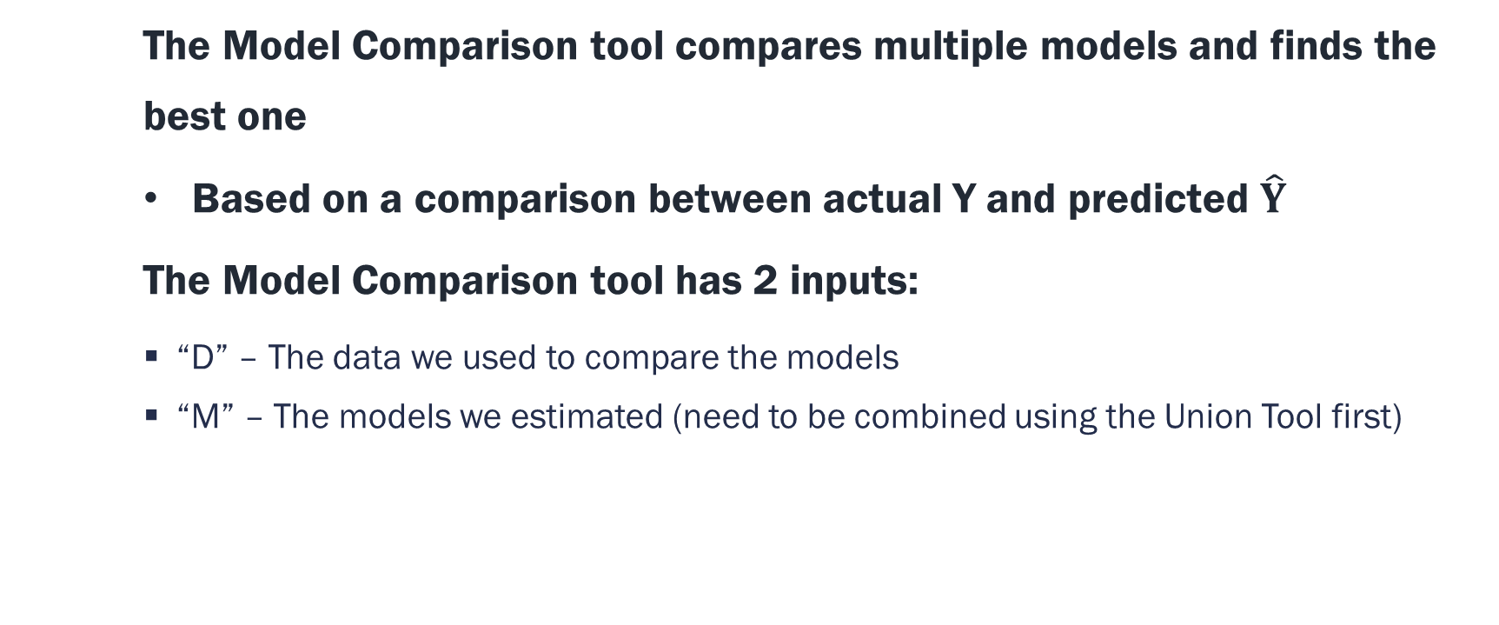
Model Comparison
The Model Comparison tool compares multiple models and finds the best one
Based on a comparison between actual Y and predicted $\hat{Y}$
The Model Comparison tool has 2 inputs:
  “D” – The data we used to compare the models
  “M” – The models we estimated (need to be combined using the Union Tool first)

Slide 33
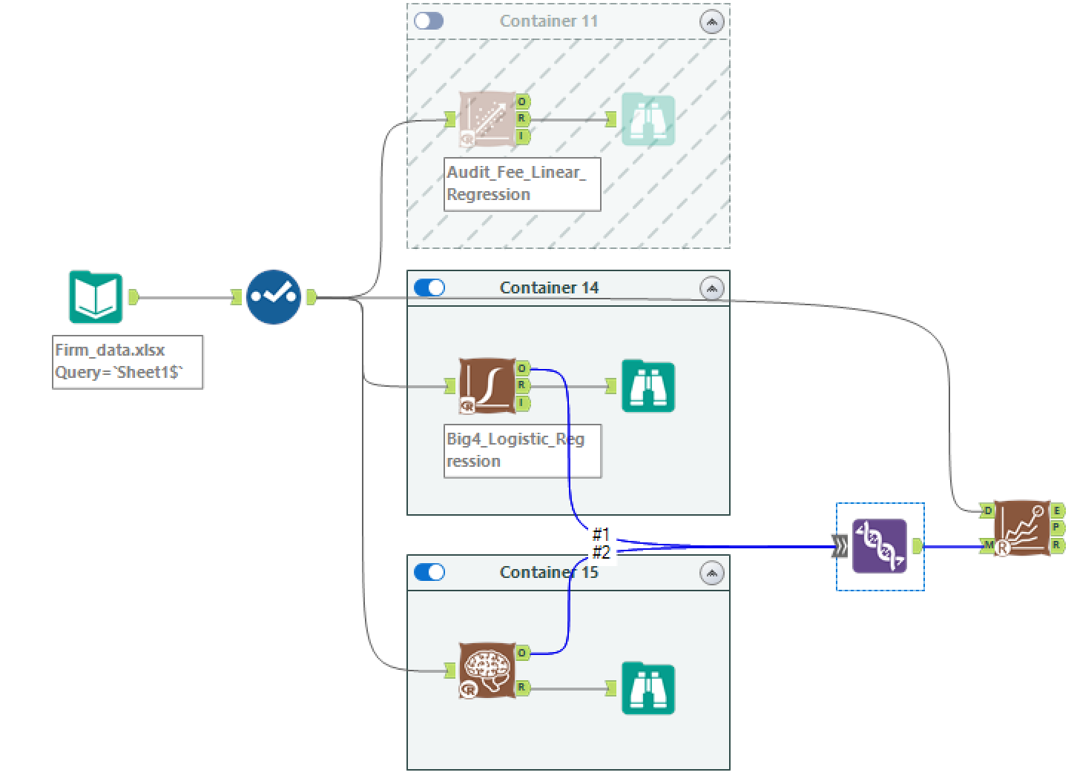
Model Comparison Workflow 1

Slide 34
Model Comparison Output 1
The “E” output anchor shows the comparison results
In most cases, models of higher accuracy are better
Then higher F1 and AUC

Slide 35
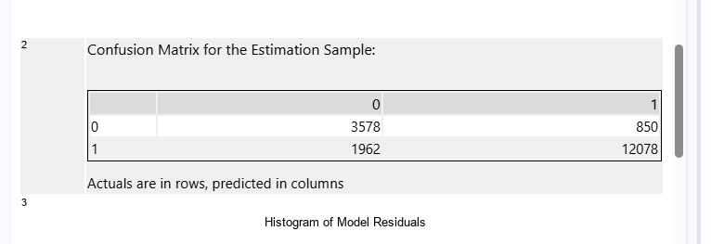
Confusion Matrix
E.g. one from neural network report
After estimating models, we use them to estimate Pr(Y=1)
  If Pr(Y=1) >= 0.5, then predicted Y = 1
  If Pr(Y=1) < 0.5, then predicted Y = 0
Thus, each observation falls into one of the four cases in the confusion matrix below
 | Actual Y = 1 | Actual Y = 0
Predicted Y = 1 | A | B
Predicted Y = 0 | C | D

Slide 36
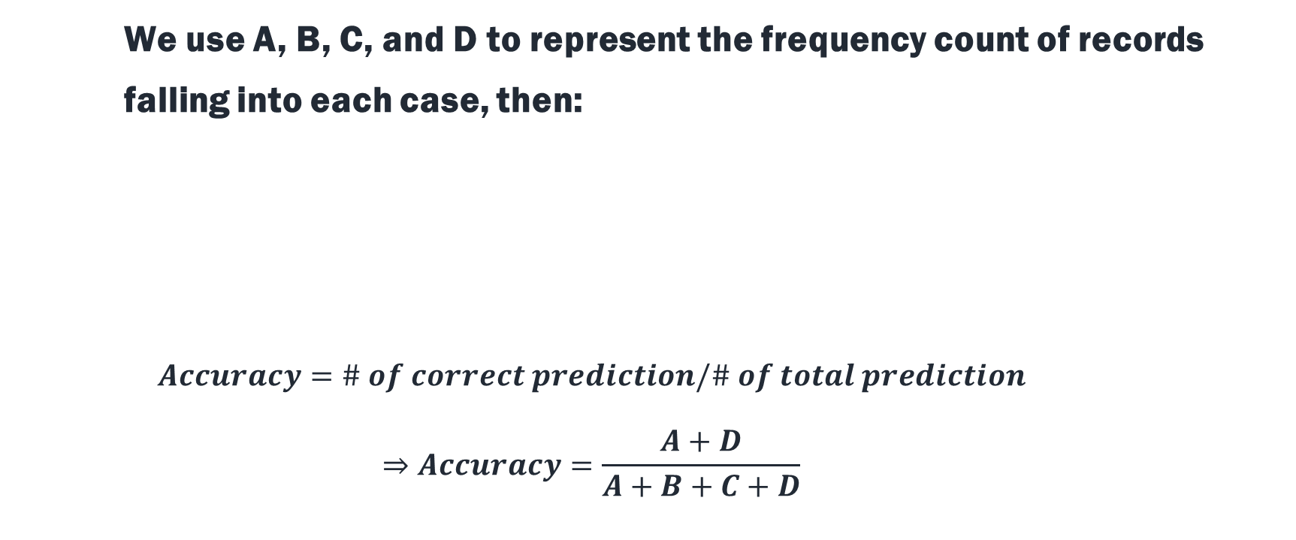
Accuracy
We use A, B, C, and D to represent the frequency count of records falling into each case, then:
$$Accuracy=\# of correct prediction/\# of total prediction$$
$$⇒Accuracy=\frac{A+D}{A+B+C+D}$$
 | Actual Y = 1 | Actual Y = 0
Predicted Y = 1 | A | B
Predicted Y = 0 | C | D

Slide 37
The Limitation of Accuracy
If a rare disease occurs in 1 out of 1,000,000 cases, and a completely uninformative model always predicts negative, what is the accuracy?
For unbalanced data, F1 and AUC (Area Under the receiver operating characteristic Curve) are more reliable
 | Actual Positive | Actual Negative
Predicted Positive | 0 | 0
Predicted Negative | 1 | 999,999

Slide 38
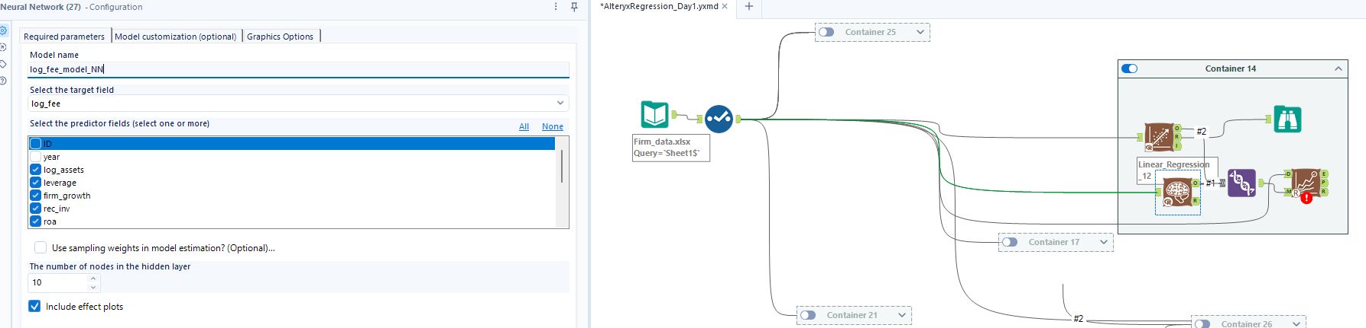
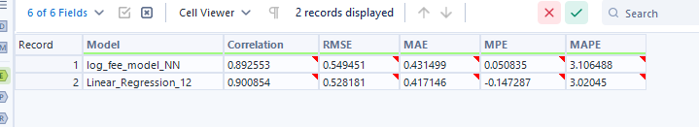
Practice: Linear Regression vs. Neural Network
Create a workflow to compare the audit fee linear regression with an audit fee neural network model using the same predictors
Note: Make sure to add a model name to the neural network model; otherwise, the model comparison tool will report errors
Don’t forget to name the NN or else comparison won’t work

Slide 39
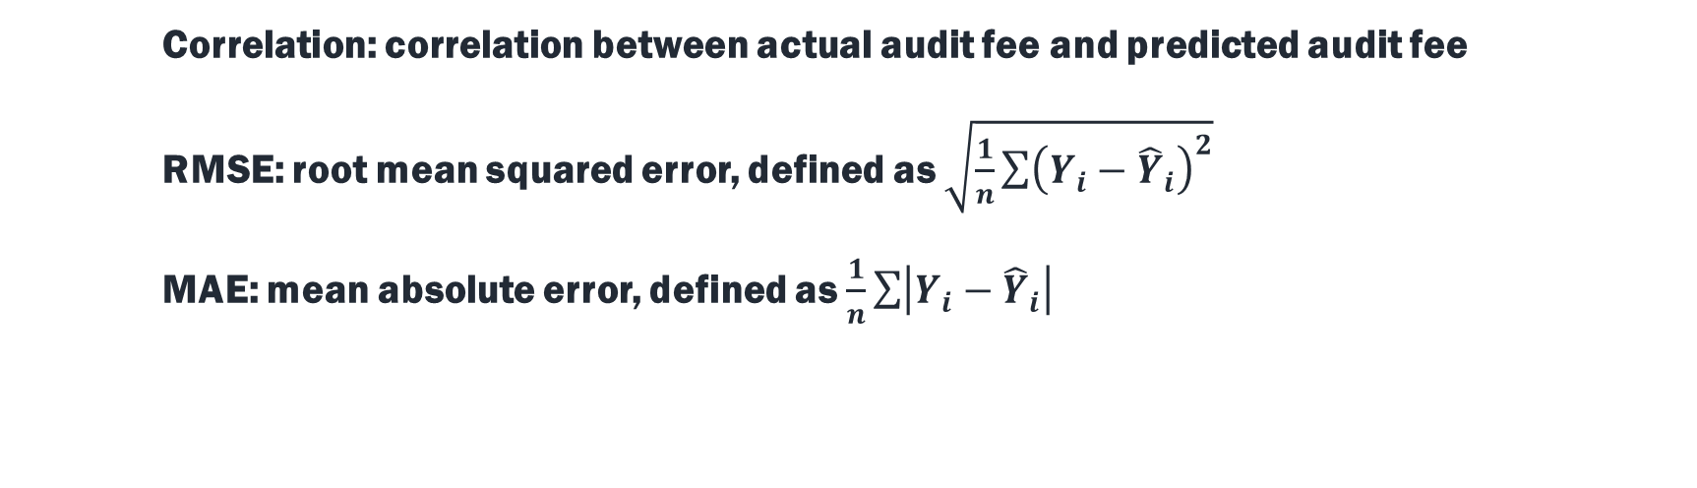
Comparison Results
Correlation: correlation between actual audit fee and predicted audit fee
RMSE: root mean squared error, defined as $\sqrt{\frac{1}{n}\sum{{\left(Y_{i}−{\hat{Y}}_{i}\right)}^{2}}}$
MAE: mean absolute error, defined as $\frac{1}{n}\sum{\left|Y_{i}−{\hat{Y}}_{i}\right|}$
You want a lower RMSE

Slide 40

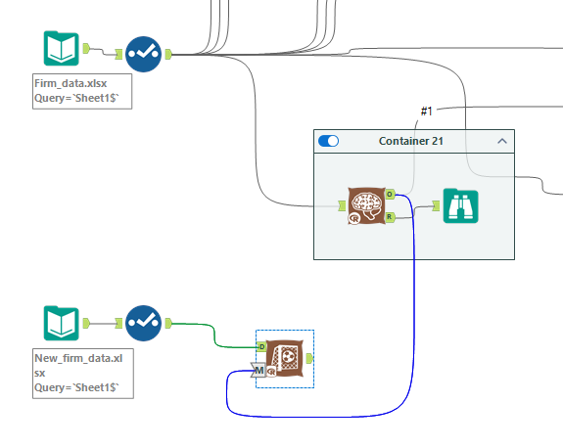
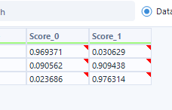
Score
Score tool is used to predict outcomes (Y) based on predictors (X)
Score tool has 2 inputs:
  “D” – The predictors data (e.g., the new firms data)
  “M” – The model used to predict Y (e.g., Big 4 choice)
50% is the cutoff value

Slide 41
Prediction 1: Big 4 Auditor Choice
Score_0 and Score_1 represent the predicted probability of choosing a non-Big 4 auditor and a Big 4 auditor, respectively

Slide 42
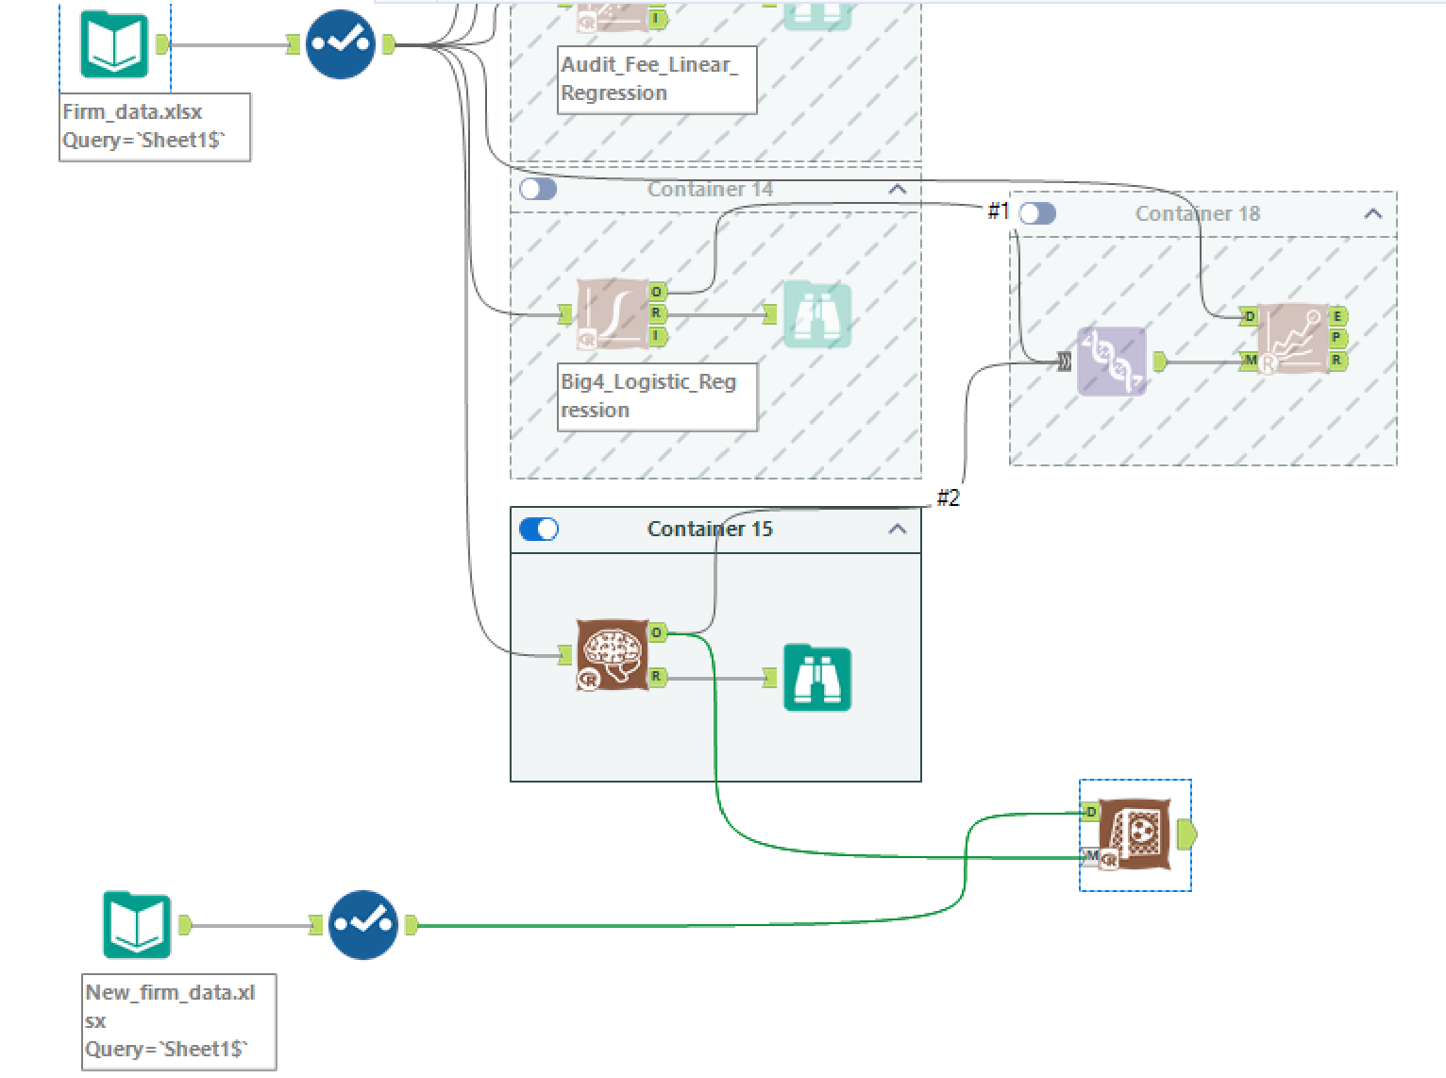
Prediction Workflow 1

Slide 43
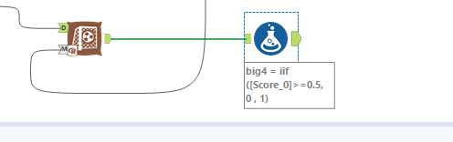
Prediction 2: Audit Fee
The linear regression results show that audit fees depend on auditor type (Big 4 or non-Big 4)
Thus, the audit fee prediction depends on the results of our auditor choice prediction
How to add a column to present the auditor choice (i.e., 1 = Big 4 & 0 = non-Big 4)?
If formula

Slide 44
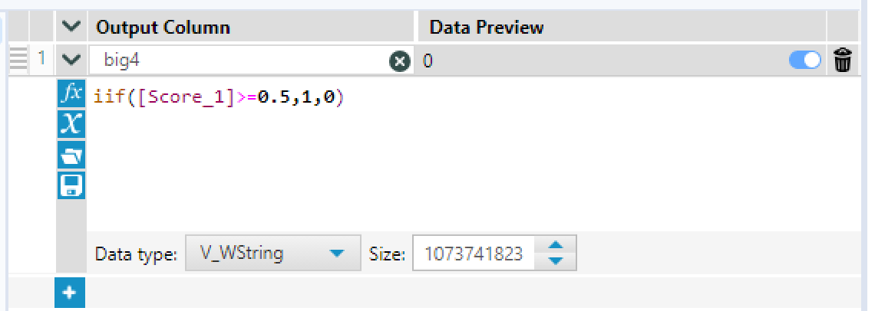
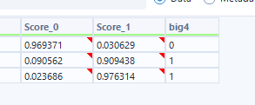
IF function in Alteryx
IIF(logical test, value if true, value if false)

Slide 45
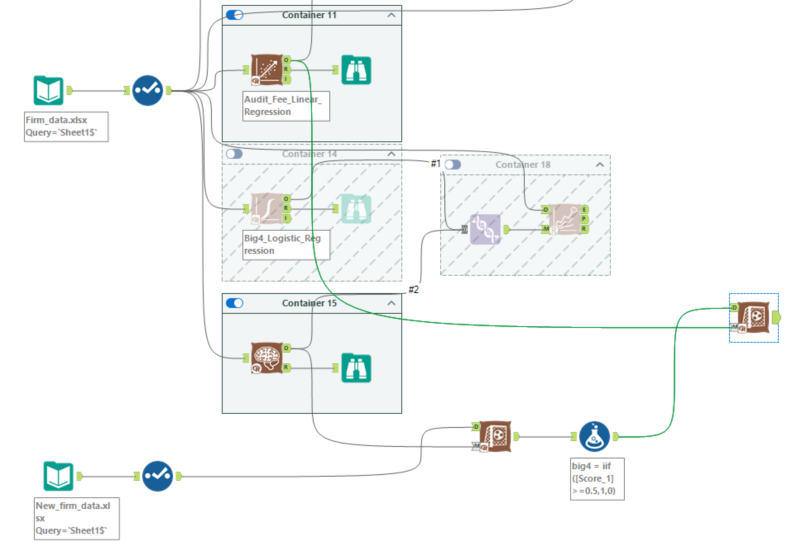
Prediction Workflow 2
Use the predicted big4 data source (name should match here so it can fill into the model)

Slide 46
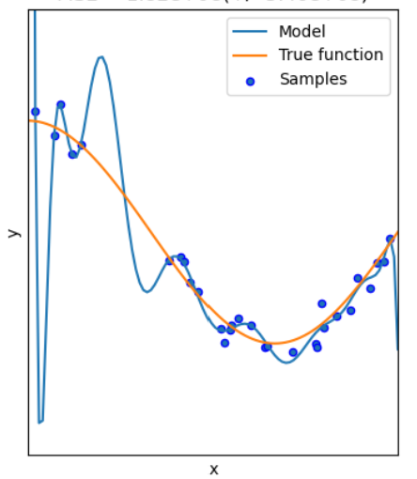
Overfitting
Overfitting occurs when a model fits too closely to the training data, resulting in a model that can’t make accurate predictions
Sample is the training data here; model shown is an example model that fits the data well (goes through almost every single point), but doesn’t reflect the true function
An example with AI is that hallucination is usually driven by overfitting.
For neural networks, this is very important (less so for linear regression)

Slide 47

Solution – Splitting sample
To avoid the overfitting problem, we can split the full sample into
  An estimation sample (E) ➔ for estimating models
  A validation sample (V) ➔ for comparing models
  A holdout sample (H) ➔ for evaluating the “best” model
Use the Create Samples tool to create subsamples
  Setting sample percentages to 60-20-20 often work well
  The random seed (an integer ranging from 1 to 1000) determines how samples are randomly created
Splitting this step out primarily tests overfitting

Slide 48
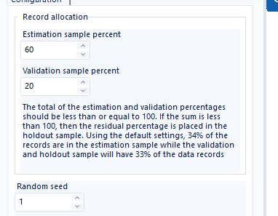
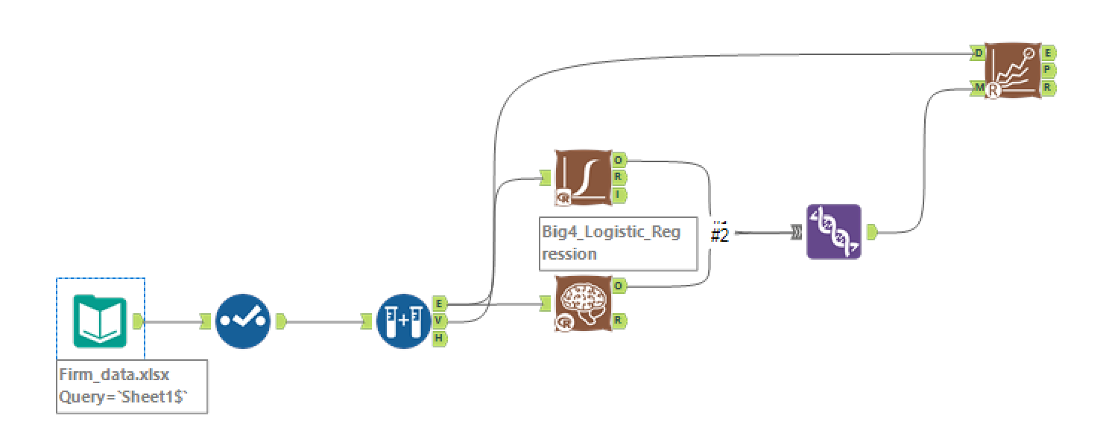
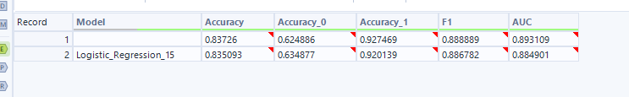
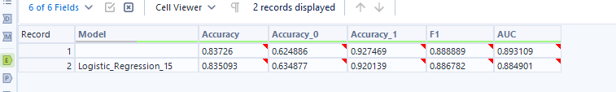
Model Comparison Workflow 2
Holdout is the remainder
As we can see overfitting is not an issue, same conclusion as when we estimated the model before

Slide 49
Model Comparison Output 2
The comparison results below is based on seed = 1 and 2, respectively
Because different starting random number (seed), randomness in estimation bc of the sample picking

Slide 50
Why Do We Need the Holdout Sample?
Selecting models based on accuracy/F1 often overestimates the “best” model’s performance
Because model selection is also a “random” process, and the estimated accuracy also contains error, depending on the randomly selected validation data
Example:
  The accuracy of Model 1 is 90%, regardless of what validation data is used
  The accuracy of Model 2 is also 90%, but the estimated accuracy ranges between 80% and 100%, depending on the validation data
  If a specific validation sample indicates Model 2 is better, then its estimated accuracy must be better than its “true” accuracy, i.e., 90%

Slide 51
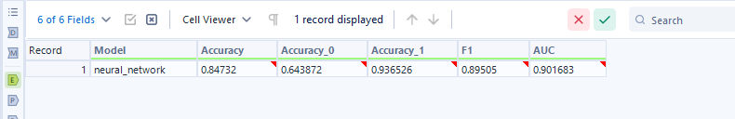
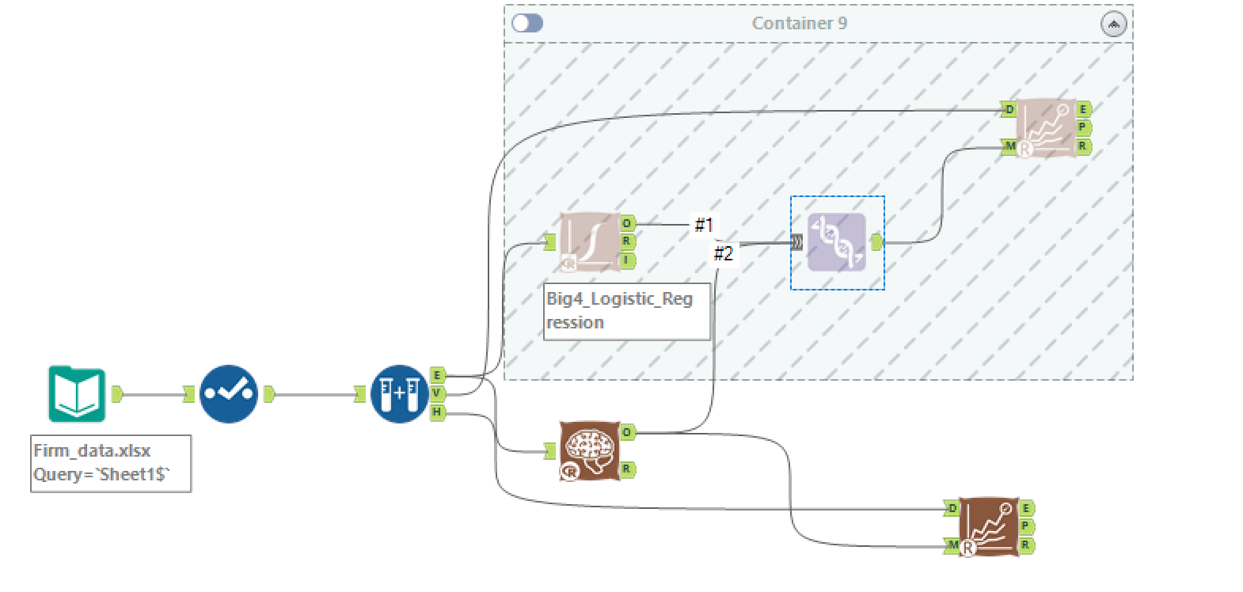
Model Evaluation
We can use Model Comparison tool to evaluate model using the holdout sample
Estimation, Validation, Holdout

